Slide 1
Hierarchical Logic Graphs for Grounding Goals and Answering Questions
James Kirk
james.kirk@cic.iqmri.org
45th Soar Workshop
May 5, 2025

Slide 2
Motivation
Need to be able to ground and reason over complex goals and questions
Direct response from LLM are good, but can struggle with handling complex goals and questions which can include
involved calculations and spatial reasoning
complex combinations of tests and calculations
references to unseen/ungroundable objects
reasoning over historic information
Explorations with intermediate soar representations for question answering required creating custom query formats and interpretation code for each type of question
Hierarchical Logic Graphs (HLG) provide a general format for representing both goals and questions that can be grounded by a Soar agent
*Based on representation and recursive grounding strategy developed during my thesis for representing and grounding goals, actions, and concept definitions
Extending to support questions and new types of tests and calculations
*Kirk, J. (2019). Learning Hierarchical Compositional Task Definitions through Online Situated Interactive Language Instruction (Doctoral dissertation). Kirk, J. R., & Laird, J. E. (2019). Learning hierarchical symbolic representations to support interactive task learning and knowledge transfer. IJCAI 2019. AAAI Press.

Slide 3

Hierarchical Logic Graphs (HLG)
HLGs represent general logic in a DAG that the agent can evaluate
Represents a conjunction of predicates test (such as apply-property) evaluated bottom up
Agent evaluates by performing calculations and grounding to current situation
Increases the generality and supported complexity of goals/questions
Simple example: “What is color of the cup?”
Generated DAG:
General Formulation:
$$f\left(x_{1},…,x_{m}\right)=\bigcap_{i=1}^{n}{f_{i}\left(x_{j}…\right)}(1≥j≥m)$$
attribute-of
apply-property
“color”
x_{j} : {objects/entities, values, sets, world states}
f_{i} : predicate terms
m: number of objects
n: number of terms (f_{i} predicates)
World context
“category”
“cup”

Slide 4
HLG Representation and Evaluation
Nodes represent conjunctions of different predicate tests
Properties (id, weight, color, cooked-state, dirty-state, speed, …)
Math: (max/min, unit conversion, addition, subtraction, division, …)
Spatial properties (position…), calculations (distance, …), and relations (on, in, …)
Temporal properties (time), relations (while, when, …)
Agent traverses HLG down and evaluates bottom-up
Grounds to the current situation or retrieved situations (episodic memory)
Evaluates each predicate using items, sets, and context computed bottom-up from graph’s lower layers
Produces a successful grounding/answer OR the nodes that cannot be satisfied/grounded

Slide 5
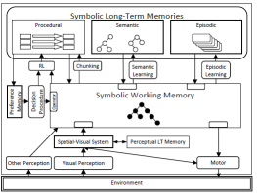

Using LLMs for generation
Prior work generated HLGs from Soar NLP over limited supported syntax
Primarily targets learning goals, concepts, and actions for games & puzzles
Now via Language Model Connector, agent prompts LLM with user question/goal, agent world context (e.g., objects, properties, relations) , and example conversions to produce a HLG (JSON ↔ Soar)
Agent then interprets HLG, evaluating nodes and performing required calculations
Evaluate
Question + Template + Context
“What is the color of…?”
LLM Connector
Question as HLG
Human Operator
“Red”
Soar Agent

Slide 6
Historical question example
“While the cargo ship was going north what was the max speed of the Oceanic?”
5. Calculates maximum of those speeds
maximum
4. Extracts speed from each Oceanic occurrence
3. Evaluates against these states finds instances of Oceanic
attribute-of
apply-property
“speed”
2. Evaluation of “while” returns set of world states to be used as input context
while
“id”
“Oceanic”
apply-property
1. Agent generates an epmem query to retrieve all episodes (past world states) where the query matches
apply-property
“direction”
“north”
world
“type”
“cargo”

Slide 7
Goal example with ThorSoar MEA
“Goal is a cooked potato on the countertop.”
(Potato50, on, Countertop19)
Desired:Potato50 on Countertop19
apply-relation
Desired:Potato50 cooked-state: cooked
Potato50
Countertop18, Countertop19, Countertop20
apply-property
“on”
apply-property
Potato50
apply-property
“cook-state”
“cooked”
world
“category”
“countertop”
world
“category”
“potato”

Slide 8
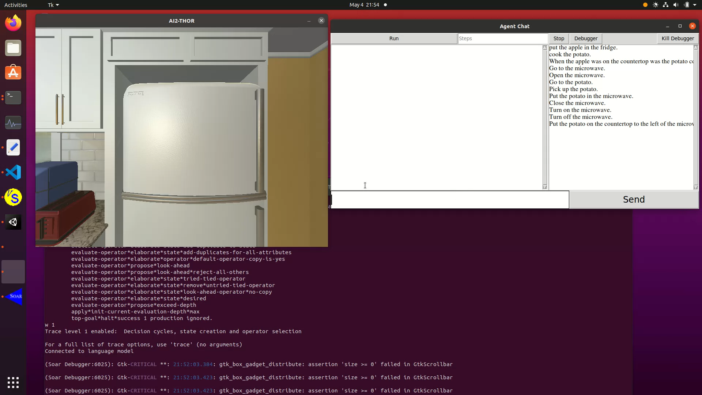

Slide 9
QA Comparison of direct LLM vs. HLG
Initial testing on small set (6) of complex questions
More extensive experiments planned
LLM is given log as context to answer historical questions
Surprisingly(?) direct LLM answering performs almost as accurately with more advanced models
But long response times
Expensive LLM usage with long logs
Struggles with historical questions when the log is long
Mode (Model) | Number Correct | Average Response Time (seconds) | Rough number of Tokens | $ Cost: 1M Input Tokens
LLM only (4o) | 2 | 0.9 | 100K | $2.50
LLM only (o3-mini) | 5 | 9.8 | 100K | $1.10
LLM only (o1) | 5-6 | 18.1 | 100K | $15.10
HLG (4o) | 6 | 2.4 | 2.5K | $2.50

Slide 10


Nuggets & Coal
Nuggets
Coal
Keeping thesis work alive!
Replacing limited language usage with language interpretation capabilities of LLMs
Working for multiple purposes (goals and QA)
Applied in multiple projects/domains
Showing good integration of CA abilities (episodic memory), LLMs (for NL conversion), and ITL
Lacks support currently for complex conjuctions and disjunctions & still some set functionality to port
Need better strategy for integration of MEA and HLG for more complex goals
Long prompt due to growing examples
Need to experiment with approaches such as finetuning and DSPy
More experiments to evaluate LLM vs. HLG
Chunking not implemented yet

Slide 11
Questions?

Slide 12
More examples
Mathematical Calculations
“How many kph is the car going?”
Converts internal representation (mph) to kph
Spatial Properties
“What is the distance between the two ships?”
Generates and evaluates the Haversine formula for computing distance using lat/long
Conjunctions
“At its current speed, how long would it take Ship-A to reach the Ship-B?”
Performs calculations, including Haversine formula, unit conversion, and division
Historical Information
“When the Oceanic was leaving Port-A, how many ships were traveling to Port-B?”
Retrieves past experiences from episodic memory, finds ships traveling to Port-B and counts sets

